Slide 1
Diabetes prediction using AI

Slide 2
TEAM MEMBERS
SANJAY
PRATHEESH KUMAR
UKESH KUMAR
SUSHMAN
POTHAN KUMAR

Slide 3
Introduction
WE KNOW THAT DIABETES IS ONE OF THE HEALTH ISSUES WHICH CAUSES DAMAGE TO THE BEINGS AND LEAD TO DEATH IT CAN EVEN PASSES THROUGH GENERATION SO WE GOING PREDICT BEFORE IT IS SERVRE
SO IN THIS WE GOING TO SEE THROUGH THE PARAMETERS WHICH ARE USED TO DETECT THE DIABETES IN BEFORE AND HOW TO PREDICT THE DIABETES USING AI

Slide 4
Patient history
Family history of diabetes is most important thing should be verified before taking the test
Body mass index of the patient is being monitored by our model if it is high it leads to two types of diabetes
In this model there are some collecting the blood pressure of the patient and given to the algorithm used in this model and it should be monitored and if it higher than the human controlled levels it is taken account.
Cholorestal level is collected by our model and used to find the health of the patient it is also a important factor which causes diabetes.

Slide 5
CLINCIAL DATA
asting Blood Glucose: Elevated fasting blood glucose levels (typically taken after an overnight fast) can be a strong indicator of diabetes. A fasting blood glucose level of 126 milligrams per deciliter (mg/dL) or higher is generally considered diagnostic for diabetes.
HbA1c Levels: HbA1c reflects the average blood glucose level over the past 2-3 months. An HbA1c level of 6.5% or higher is typically used to diagnose diabetes.
Oral Glucose Tolerance Test (OGTT): In this test, glucose levels are measured before and after the consumption of a glucose-rich drink. A 2-hour blood glucose level of 200 mg/dL or higher indicates diabetes.

Slide 6
REAL TIME MOINTORING
Continuous Glucose Monitoring using AI can analyze data from CGM devices to predict glucose trends and alert patients to potential highs or lows.
Prediction using can assess a patient's risk of developing diabetes by analyzing their health data, such as family history, BMI, and blood sugar levels.
Medication Management using AI can help patients and doctors determine the most effective medications and dosages based on individual responses.
Lifestyle of the person can provide personalized diet and exercise recommendations to help manage or prevent diabetes.
Telemedicine is the AI-powered we refer the the doctor in online .

Slide 7
CLINICAL VALIDITY
Clinical validation for predicting diabetes typically involves assessing the accuracy and reliability of predictive models or diagnostic tests. This can be done through retrospective and prospective studies using patient data. Various factors, such as sensitivity, specificity, positive predictive value, and area under the receiver operating characteristic curve, are commonly used to evaluate the predictive performance of models or tests. The validation process helps ensure that the prediction is robust and can be applied effectively in a clinical setting. If you have specific questions or need more information, please let me know.

Slide 8
PRIVACY AND SECURITY
Privacy and security are important considerations in the development of AI tools for diabetes management and protection. AI applications in this field should adhere to strict data protection standards and security measures to safeguard sensitive patient information. These measures may include encryption, user authentication, access controls, and compliance with data privacy regulations like GDPR or HIPAA, depending on the region. It's crucial to prioritize patient privacy and data security when implementing AI solutions for diabetes care.

Slide 9
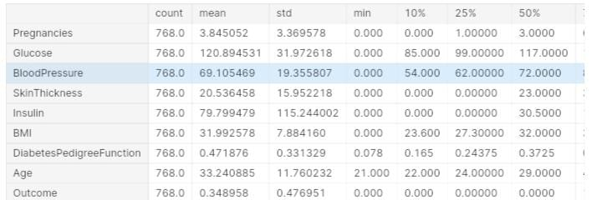
DATAS FOR PREDICTION

Slide 10
PROGRAM FOR THE MODEL
import pandas as pd
import numpy as np
import matplotlib.pyplot as plt
import seaborn as sns
Importing dataset
dataset = pd.read_csv('../input/diabetes-data-set/diabetes.csv')
Viewing the dataset, its dimensions, features and statistical summary
dataset.head()
dataset.shape
(768, 9)
dataset.info()
<class 'pandas.core.frame.DataFrame'>
RangeIndex: 768 entries, 0 to 767
Data columns (total 9 columns):
# Column Non-Null Count Dtype
--- ------ -------------- -----
0 Pregnancies 768 non-null int64
1 Glucose 768 non-null int64
2 BloodPressure 768 non-null int64
3 SkinThickness 768 non-null int64
4 Insulin 768 non-null int64

Slide 11
5 BMI 768 non-null float64
6 DiabetesPedigreeFunction 768 non-null float64
7 Age 768 non-null int64
8 Outcome 768 non-null int64
dtypes: float64(2), int64(7)
memory usage: 54.1 KB
dataset.describe().T
dataset.isnull().sum()
#OUTPUT OF NULL VALUES
Pregnancies 0
Glucose 0
BloodPressure 0
SkinThickness 0
Insulin 0
BMI 0
DiabetesPedigreeFunction 0
Age 0
Outcome 0
dtype: int
#DATA VISUALISATION
sns.countplot(x = 'Outcome',data = dataset)
<Axes: xlabel='Outcome', ylabel='count'>
[25/10, 7:38 pm] Sanjay Bro: sns.pairplot(data = dataset, hue = 'Outcome')
plt.show()
sns.heatmap(dataset.corr(), annot = True)
plt.show()

Slide 12
dataset_new = dataset
dataset_new[["Glucose", "BloodPressure", "SkinThickness", "Insulin", "BMI"]] = dataset_new[["Glucose", "BloodPressure", "SkinThickness", "Insulin", "BMI"]].replace(0, np.NaN)
# Count of NaN
dataset_new.isnull().sum()
#OUTPUT OF NEW DATASET
Pregnancies 0
Glucose 5
BloodPressure 35
SkinThickness 227
Insulin 374
BMI 11
DiabetesPedigreeFunction 0
Age 0
Outcome 0
dataset_new["Glucose"].fillna(dataset_new["Glucose"].mean(), inplace = True)
dataset_new["BloodPressure"].fillna(dataset_new["BloodPressure"].mean(), inplace = True)
dataset_new["SkinThickness"].fillna(dataset_new["SkinThickness"].mean(), inplace = True)
dataset_new["Insulin"].fillna(dataset_new["Insulin"].mean(), inplace = True)
dataset_new["BMI"].fillna(dataset_new["BMI"].mean(), inplace = True)
dataset_new.isnull().sum()
#OUTPUT OF DATASET
Pregnancies 0
Glucose 0
BloodPressure 0
SkinThickness 0
Insulin 0

Slide 13
BMI 0
DiabetesPedigreeFunction 0
Age 0
Outcome 0
dtype: int64
y = dataset_new['Outcome']
X = dataset_new.drop('Outcome', axis=1)
# Splitting X and Y
from sklearn.model_selection import train_test_split
X_train, X_test, Y_train, Y_test = train_test_split(X, y, test_size = 0.20, random_state = 42, stratify = dataset_new['Outcome'] )
from sklearn.linear_model import LogisticRegression
model = LogisticRegression()
model.fit(X_train, Y_train)
y_predict = model.predict(X_test)
y = dataset_new['Outcome']
X = dataset_new.drop('Outcome', axis=1)
# Splitting X and Y
from sklearn.model_selection import train_test_split
X_train, X_test, Y_train, Y_test = train_test_split(X, y, test_size = 0.20, random_state = 42, stratify = dataset_new['Outcome'] )
from sklearn.linear_model import LogisticRegression
model = LogisticRegression()
model.fit(X_train, Y_train)
y_predict = model.predict(X_test)

Slide 14
y_predict
from sklearn.metrics import confusion_matrix
cm = confusion_matrix(Y_test, y_predict)
cm
sns.heatmap(pd.DataFrame(cm), annot=True)
from sklearn.metrics import accuracy_score
accuracy =accuracy_score(Y_test, y_predict)
accuracy

Slide 15
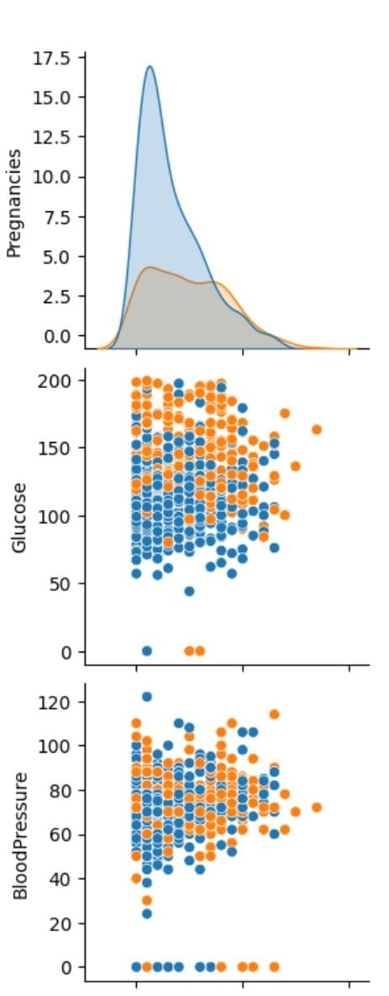
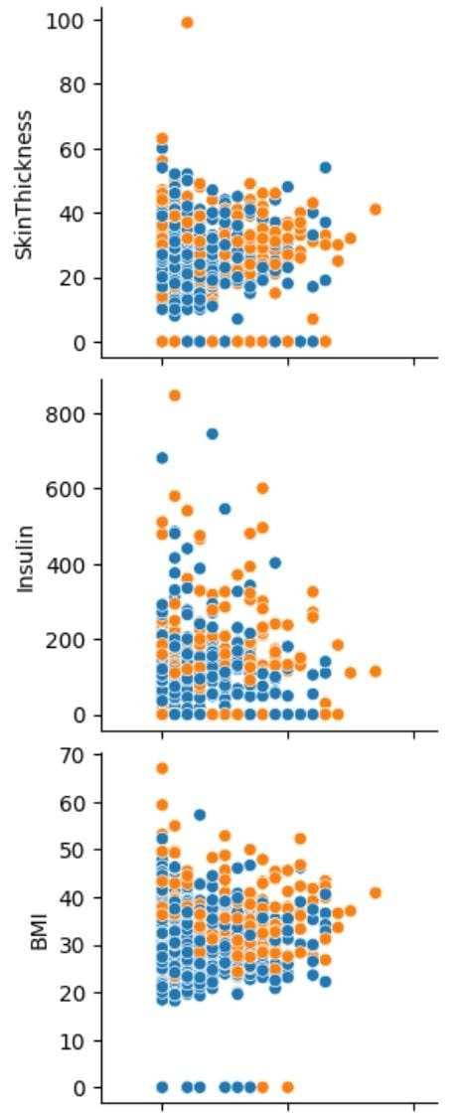
OUTPUTS OF THE ANALYSIS

Slide 16
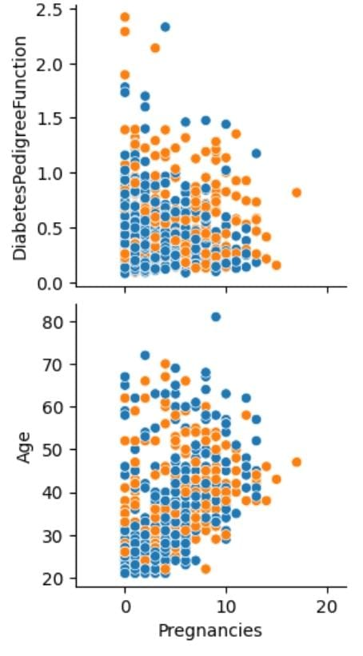

Slide 17
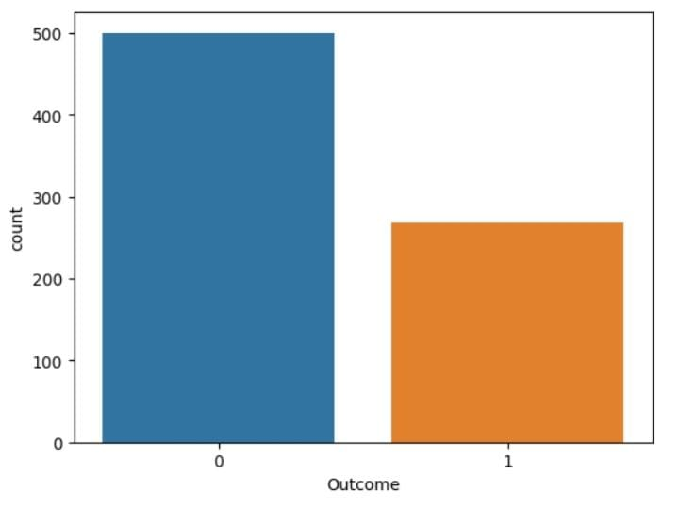
COUNT VS OUTCOME

Slide 18
DECISION MAKING
y_predict = model.predict([[1,148,72,35,79.799,33.6,0.627,50]])
(y_predict)
if y_predict==1:
Print(“The patient has Diabetes")
else:
(“The patient has no Diabetes")

Slide 19
OUTPUT FOR THE TEST:
The patient has diabetes
The above result is outcome of the algorithm which is test and trainied to predict diabetes .it can be used to find diabetes of different patient catgerories like pregnant etc.
So it efficient to find the cause before head and helping them.

